Slide 1
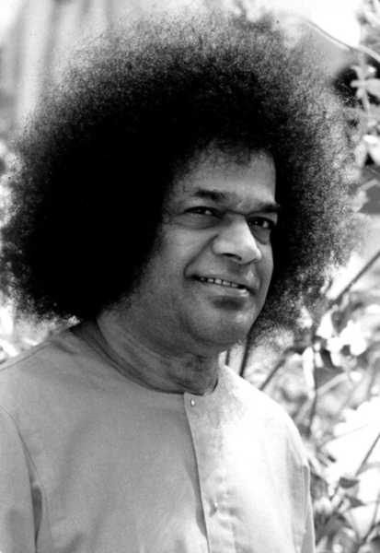

Multi-modal Cattle Verification Using Vision Transformers and Cross-Attention Refinement
Presented by:
Sai Narendra
Supervised By:
Prof. SVSN Sarma, Asst. Professor, Mathematics & Computer Science, SSSIHL
Dr. Darshan Gera, Associate. Professor, Mathematics & Computer Science, SSSIHL

Slide 2
Problem Statement and Introduction
Introduction
overview & proposed solution
Why Cattle Verification?
Proposed Two-Stage Framework
Disease traceability & livestock management
Insurance validation & ownership authentication
Food supply chain transparency
Theft prevention
1:1 matching — does this sample belong to this animal?
Different from identification (1:N closed-set)
Stage 1
Shared ViT-Base/16 backbone learns modality-invariant 512-dim embeddings from face
Stage 2
Lightweight Cross-Attention Refinement (CAR) module models bidirectional face↔muzzle dependencies.
Loss
Limitations of Existing Methods
Multi-Similarity Loss with Hard Pair Mining
Unreliable Traditional Methods
Single-modality: vulnerable to occlusion & pose variation
Naive fusion (concat/averaging) — misses cross-modal cues
Triplet loss: slow convergence, suboptimal representations

Slide 3
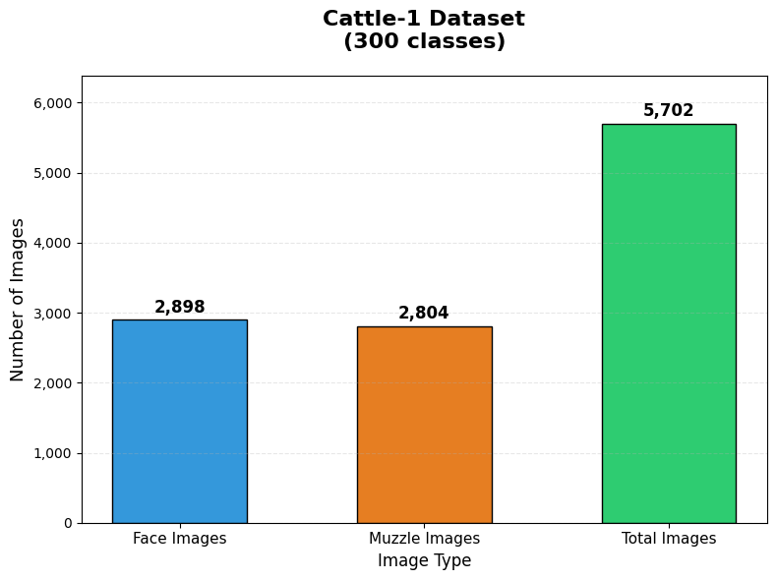
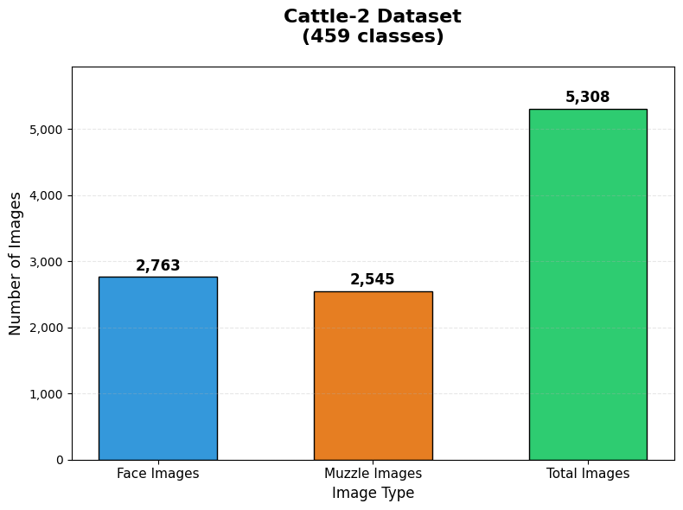
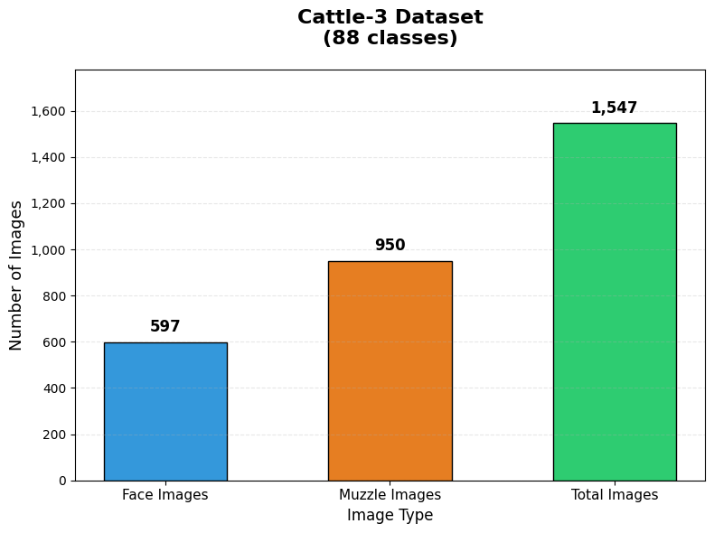
Datasets Used
Cattle-1
Cattle-2
Cattle-3 (In-house)
Shojaeipour et al., 2021
Ahmed et al., 2024
Our dataset
Animals: 300
Animals: 459 (456 used)
Animals: 88
Face: 2,898
Face: 2,763
Face: 597
Muzzle: 2,804
Muzzle: 2,545
Muzzle: 950
Images: 5,702
Images: 5,308
Images: 1,012
Fig. 1: Cattle-1 – Shojaeipour et al., 2021, agronomy
Fig. 2: Cattle-2 – Ahmed et al., 2024, Data in Brief
Fig. 3: Cattle-3 – In-house dataset

Slide 4
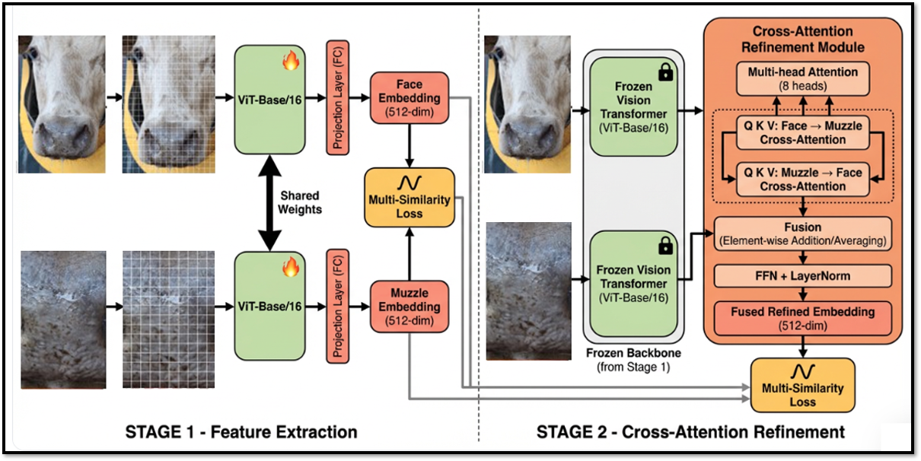
METHODOLOGY:

Slide 5
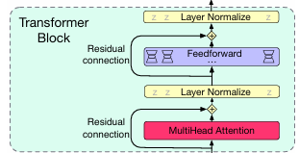

Stage 1 — Global Feature Extraction via ViT
Vision Transformer Architecture
Input Image (224×224×3)
▼
Patch Embedding
image split into 196 non-overlapping 16×16 patches
▼
Transformer Encoder
L=12 layers, H=12 heads
▼
Final embedding:
[ CLS ] Token → Projection W_proj
768 → 512 dim
▼
L₂-Normalize → e ∈ ℝ⁵¹²
Source: Jurafsky & Martin, Speech and Language Processing, 3rd ed.

Slide 6


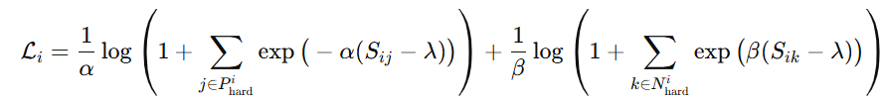
Multi-Similarity Loss with Hard Pair Mining
❌ Triplet Loss
Equal weight to all triplets → slow convergence, gradient vanishing, suboptimal at scale
Hard Pair Mining
Hard Positives — positives where a negative is closer:
Why Multi-Similarity Loss?
Hard Negatives — negatives closer than some positive:
Triplet loss only considers ONE positive and ONE negative per anchor
MS Loss uses ALL hard positives & hard negatives simultaneously
MS Loss Formulation
Adaptive pair-wise weights → richer gradient signals
Logarithmic formulation prevents gradient vanishing
Faster convergence and better embedding quality
In Stage 2: loss computed jointly over face, muzzle & fused embeddings
✅ Multi-Similarity Loss
Adaptive pair weights based on 3 similarity relations → non-zero gradient for ALL hard pairs

Slide 7

Stage 2: Cross-Attention Refinement (CAR)
Why Cross-Attention?
🔒 Backbone FROZEN in Stage 2
Preserves globally discriminative Stage-1 features while CAR learns cross-modal refinement
Stage 1 creates a shared embedding space but does NOT model the interaction between face and muzzle of the same animal.
CAR module explicitly captures bidirectional dependencies — what does the face tell us about the muzzle, and vice versa?
Information Flow in CAR
Inputs: f ∈ ℝ⁵¹², m ∈ ℝ⁵¹² from frozen backbone
Face f
Muzzle m
f→m = MHA(Q=f, K=m, V=m, H=8)
↓
m→f = MHA(Q=m, K=f, V=f, H=8)
f→m Attention
m→f Attention
f_fused = (f→m + m→f) / 2
↓
Average Fusion
↓
FFN + LayerNorm
The threshold τ∗ is the Equal Error Rate (EER) point on the validation set, where FAR(τ) = FRR(τ).
↓
e_fused ∈ ℝ⁵¹²

Slide 8
Verification Results
Metric | Stage-1 Cattle-1 | Stage-2 Cattle-1 | Stage-1 Cattle-2 | Stage-2 Cattle-2 | Stage-1 Cattle-3 | Stage-2 Cattle-3
Accuracy | 95.16 | 97.13 | 97.71 | 98.67 | 92.46 | 95.21
Precision | 95.17 | 97.11 | 97.71 | 98.69 | 92.46 | 95.38
Recall | 95.14 | 97.11 | 97.71 | 98.66 | 92.46 | 95.02
F1 Score | 95.16 | 97.14 | 97.71 | 98.67 | 92.46 | 95.20
AUC | 98.96 | 99.70 | 99.78 | 99.87 | 96.54 | 98.93

Slide 9
Comparison with biometric methods.
Method | Feature | Accuracy (%)
Awad & Hassaballah (2019) | Muzzle | 75.70
Li et al. (2022) | Muzzle | 91.00
Gaber et al. (2022) | Muzzle | 71.80
Lee et al. (2023) | Muzzle | 92.10
Xu et al. (2022) | Face | 91.30
Bergman et al. (2024) | Face | 96.30
Kumar et al. (2025) | Face+Muzzle | 93.67
Ours — Stage 1 | Face+Muzzle | 95.16
Ours — Stage 2 ✓ | Face+Muzzle | 97.13
Comparison with State of the Art methods.
Method | Cattle-1 | Cattle-2 | Cattle-3
Cattle Verification with Pair wise triplet loss Kumar et al. (2025) | 94.42 | 93.21 | 89.37
Multi-modal Cattle verification (ours) | 97.13 | 98.67 | 95.21

Slide 10
Ablation Study — Unimodal vs Multi-modal
Face-Only vs. Muzzle-Only vs. Multi-modal (Stage 2) — Accuracy %
Dataset | Cattle-1 Face | Cattle-1 Muzzle | Cattle-1 Multi ✓ | Cattle-2 Face | Cattle-2 Muzzle | Cattle-2 Multi ✓ | Cattle-3 Face | Cattle-3 Muzzle | Cattle-3 Multi ✓
Accuracy | 97.72 | 97.00 | 97.13 | 99.05 | 97.31 | 98.67 | 94.22 | 91.63 | 95.21
AUC | 99.81 | 99.66 | 99.70 | 99.96 | 99.33 | 99.87 | 98.83 | 95.28 | 98.93
Key Insights
👁 Face > Muzzle in isolation
🔗 Multi-modal wins on hard data
⚖ Fusion benefit depends on quality
On challenging Cattle-3 (Indian breeds, varied lighting), multi-modal fusion improves over face-only: 95.21% vs 94.22%. CAR leverages complementarity when both modalities are less reliable.
On Cattle-1 and Cattle-2, face-only slightly edges out fusion — but Stage-2 multi-modal still achieves the highest accuracy by combining all signals.
Face-only consistently outperforms muzzle-only. Muzzle quality can be affected by imperfect YOLO11 extraction and background noise.

Slide 11
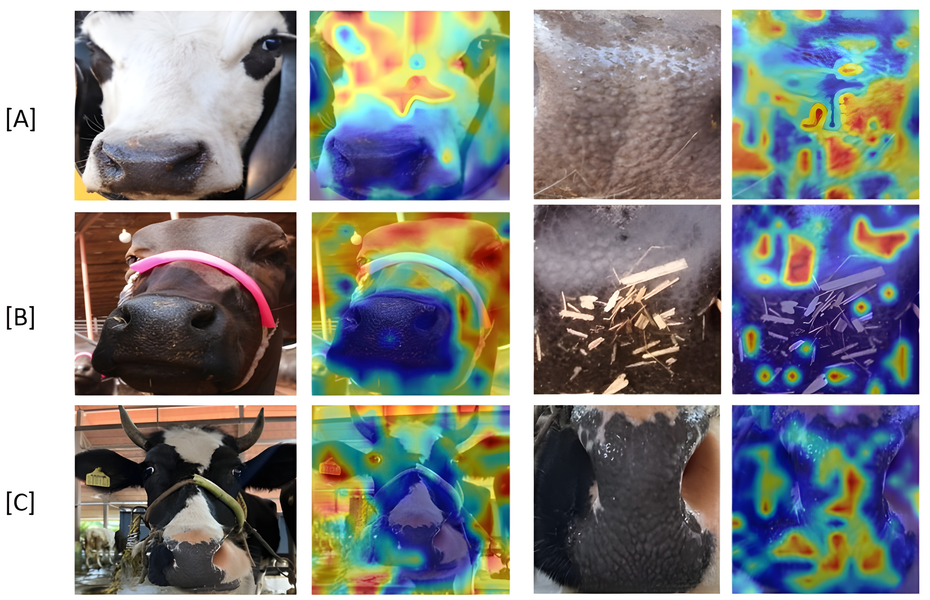
Cattle-1 (A), Cattle-2 (B), Cattle-3 (C)
Consistent attention patterns across all three datasets confirm that the ViT backbone has learned modality-appropriate discriminative features rather than dataset-specific artefacts.
This qualitative validation corroborates the quantitative results — the model is attending to the same regions a domain expert would identify as most informative for biometric identification.

Slide 12
Conclusion and Future Work
14 / 14
Contributions
Limitations & Future Work
1
Two-stage multi-modal framework: shared ViT backbone + CAR module
⚠ Small identity pool
→ Evaluate on larger, more diverse cattle populations
2
Multi-Similarity Loss with hard pair mining — outperforms triplet loss
⚠ Requires both modalities
→ Develop single-modal fallback when muzzle unavailable
3
Automated YOLO11 muzzle extraction — no manual preprocessing
⚠ Low-light not explored
→ Test under night-time, motion-blur conditions
4
State-of-the-art on 3 datasets: up to 98.67% acc. & 99.87% AUC
⚠ Compute-intensive ViT
→ Integrate MobileViT for edge/farm device deployment
5
In-house Cattle-3: first verification benchmark for Indian cattle breeds
⚠ Separate preprocessing
→ Fully integrated end-to-end pipeline with YOLO embedded

Slide 13
Paper Submission
Paper Title :
Multi-modal Cattle Verification Using Vision Transformers and Cross-Attention Refinement
Conference Name :
National Conference on Computer Vision, Pattern Recognition, Image Processing and Graphics

Slide 14
References
Kumar, N., Sharma, A., Kumar, A., et al.: Cattle verification with YOLO and cross-attention encoder-based pairwise triplet loss. Computers and Electronics in Agriculture 234, 110223 (2025). https://doi.org/10.1016/j.compag.2025. 110223
Pandey, S., Jawade, B., Setlur, S.: RidgeFormer: Multi-stage contrastive training for fine-grained cross-domain fingerprint recognition. In: Proceedings of the IEEE International Conference on Image Processing (ICIP). Anchorage, Alaska, USA (2025), arXiv:2506.01806
Shojaeipour, A., Falzon, G., Kwan, P., et al.: Automated muzzle detection and biometric identification via few-shot deep transfer learning of mixed breed cattle. Agronomy 11(11), 2365 (2021). https://doi.org/10.3390/agronomy11112365
Ahmed, S.U., Frnda, J., Waqas, M., Khan, M.H.: Dataset of cattle biometrics through muzzle images. Data in Brief 53, 110125 (2024). https://doi.org/10. 1016/j.dib.2024.110125, open access via PMC: https://pmc.ncbi.nlm.nih. gov/articles/PMC10869238/
Jocher, G., Qiu, J.: Ultralytics YOLO11. https://github.com/ultralytics/ ultralytics (2024), version 11.0.0. License: AGPL-3.0
Wang, X., Han, X., Huang, W., Dong, D., Scott, M.R.: Multi-similarity loss with general pair weighting for deep metric learning. In: Proceedings of the IEEE/CVF Conference on Computer Vision and Pattern Recognition (CVPR). pp. 5022–5030 (2019). https://doi.org/10.1109/CVPR.2019.00516
Jurafsky, D., & Martin, J. H. (2023). Speech and Language Processing (3rd ed.). Draft. Available at: https://web.stanford.edu/~jurafsky/slp3/

Slide 15
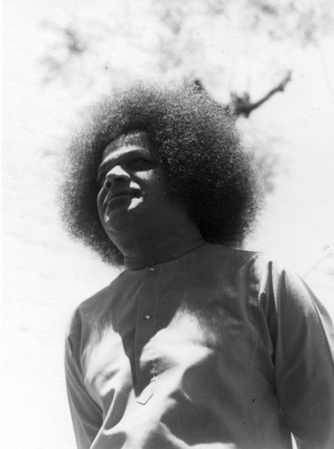
THANK YOU!

